Slide 1
Science Sunday, December 3, 2023
A four-model approach to understanding our evolutionary psychology
Jim Walter
JamesWalter889@gmail.com

Slide 2
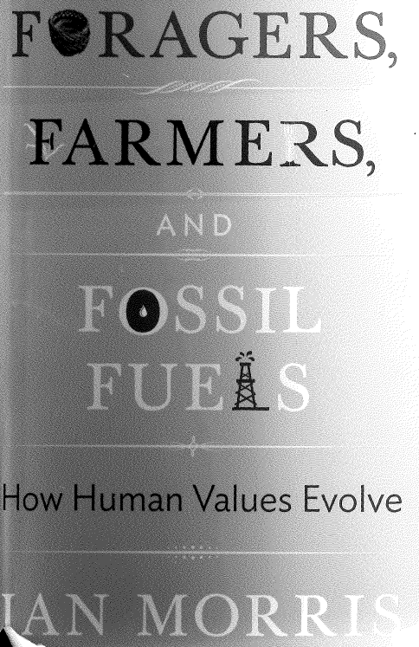
Primary References
Richard Wrangham, Ph.D. Ian Morris, Ph.D.
YouTube YouTube

Slide 4
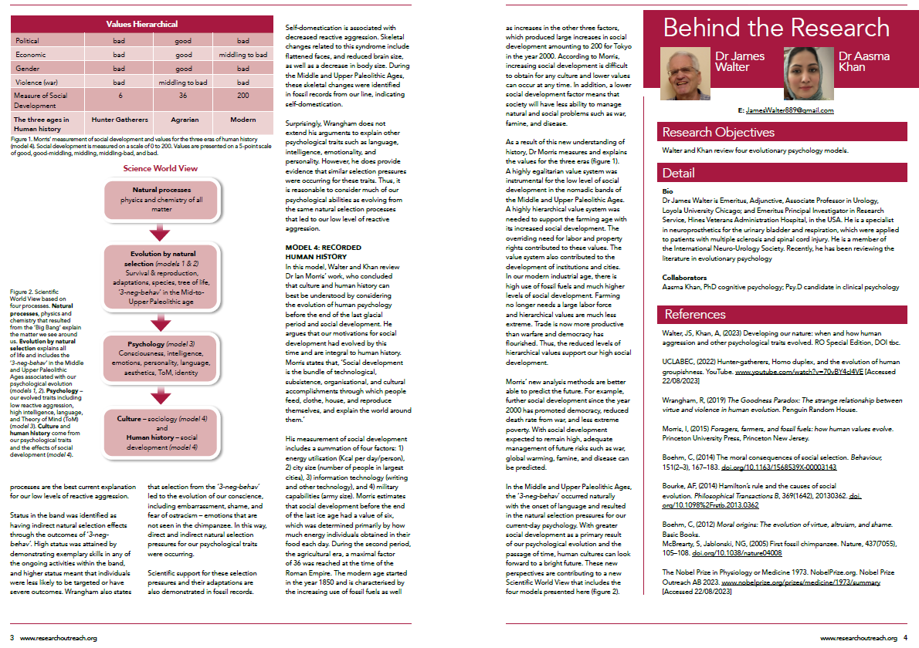

Slide 5
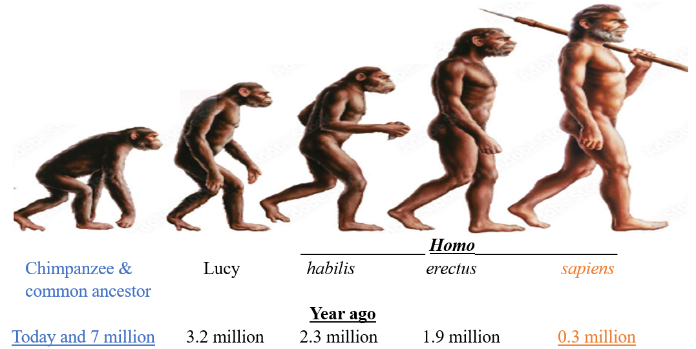
Overview
to 12,000 yrs ago
Big Model 1 Model 2 Limited information Model 3 Model 4 Scientific 3 billion
Bang Evolution Chimpanzee & hominins, Mid & Upper Human Worldview yrs future 13.7 bil earth 4.5 bil common ancestor extinct Paleolithic history ssun expand
life 3.5 bil

Slide 6
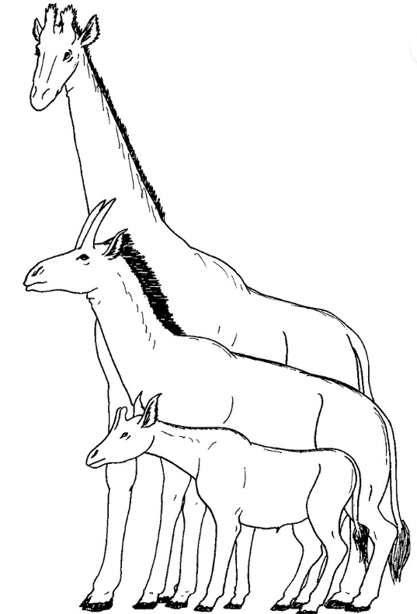
Model 1, Evolution through natural selection
Survival & Reproduction
Adaptations & new species
Sexual selection
Modern synthesis - genetics, developmental
Kin selection
‘3-neg-behav’ Mid & Late Paleolithic Ages (human psychological evolution)
giraffe

Slide 7
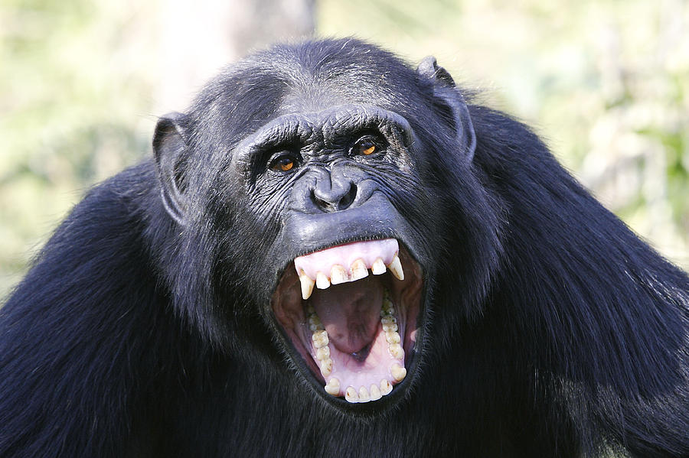
Model 2, Insights from the chimpanzee & our common ancestor
Nobel Prize - 1973, explaining behaviors of non-human animals
Chimpanzee - same daily behaviors, stereotyped
High percentage behavior - genetic, inherited, reflex
Simple reflexes - reactions such as fear, anger
Complex reflexes - signal + behaviors
- Rising sun signal initiates complex foraging
Adult chimp - 4-5 yr old child in the 3 primary areas of psychology: intelligence, emotions, personality
Chimp emotion -high reactive (anger) aggress -750↑us
Common ancestor(7 mill yrs) reactive aggress - 750↑us
Our 750 ↓ reactive aggression – occurred in hominin line
NEXT – Model 3, 3-neg-behav’ to explain our 750 ↓ reactive aggression, other traits

Slide 8
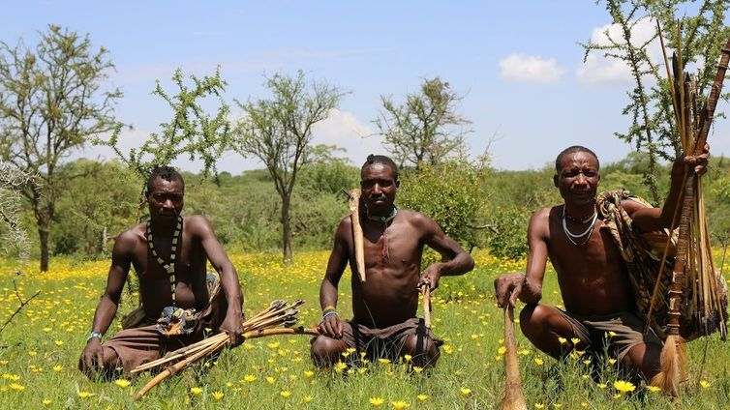
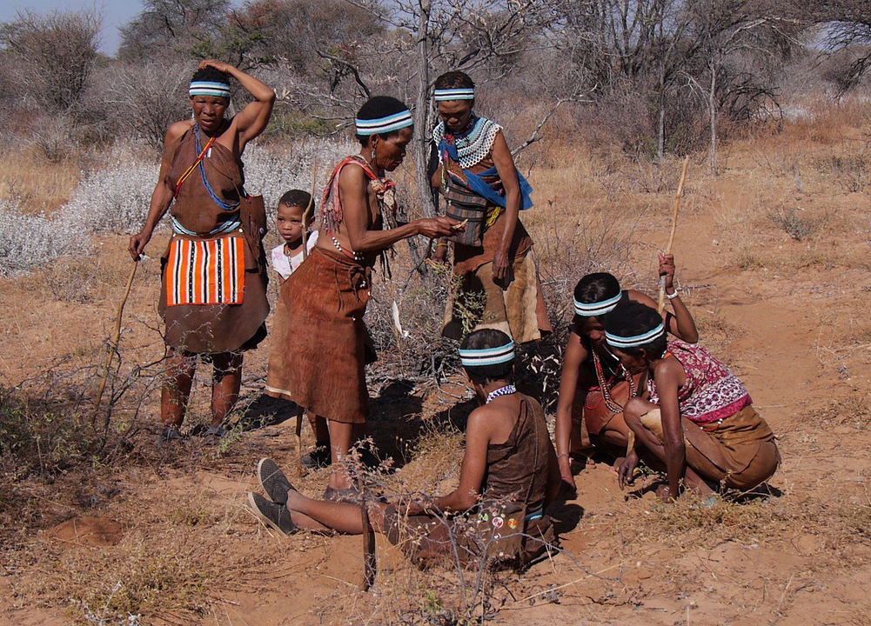
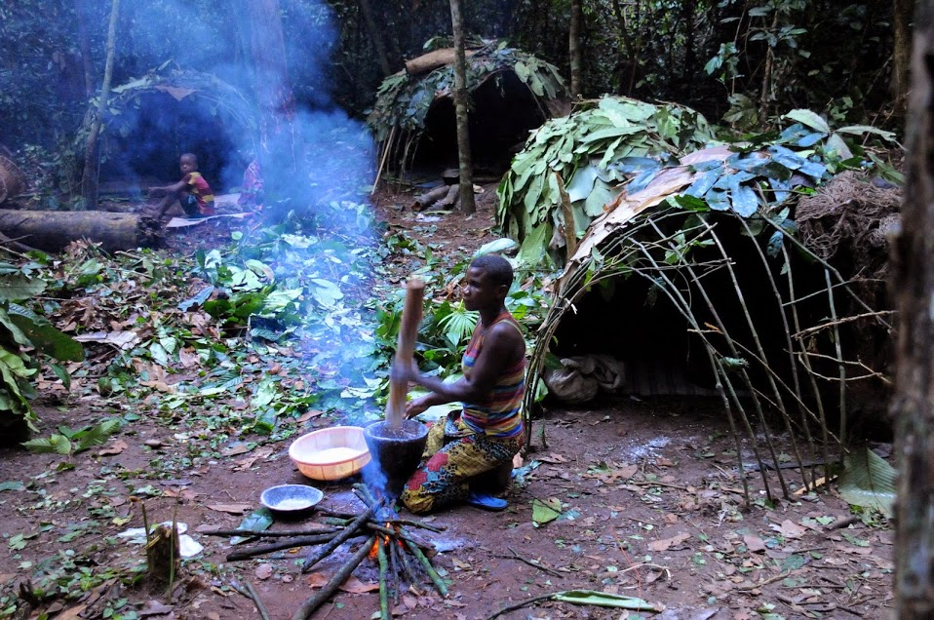
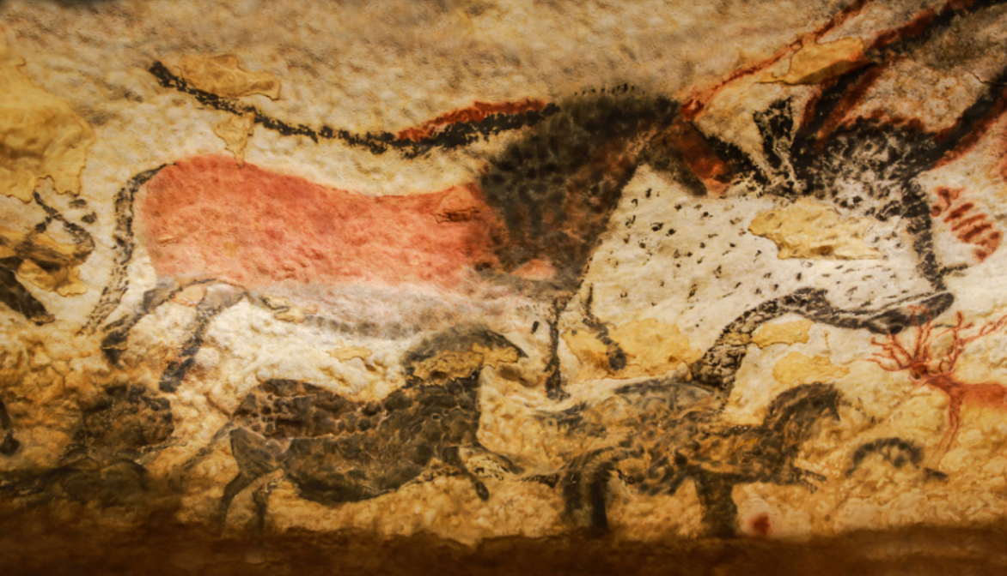
Model 3, our psychological evolution
Middle and Upper Paleolithic Ages - recent anthropology
First cultures with fully developed languages, small nomadic bands, stone tools, animists, polygamy
Highly egalitarian values – enforced (targeted) by ‘3-neg-behav’ of gossip, ostracism, and limited executions
Targeted – bullies → decreased life spans, paternity
Strong natural selection pressure – aggression ↓750, ↑conscience (good and bad), other traits
High status in the band – reduced targeting
Further evidence – domestication syndrome & fossils
Alt explanation: each trait selection, females, transition
Next - Applications of insights from ‘3-neg-behav’
Understanding ourselves – worry, moral emotions, self-talk
Next Model 4 - Understanding human culture & history

Slide 9
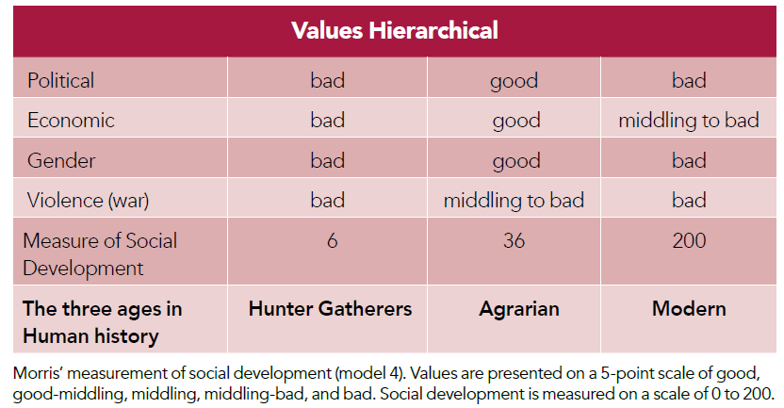
Model 4, human culture, values, & history
3. Hierarchical Values
2. Motivation for ‘Social Development’ in Hunter-gatherers; measured as 1) energy utilisation,
2) city size, 3) information technology, 4) military capabilities
1. Dr Ian Morris – history in 3 ages
- Our psychological evolved during
the hunter-gatherer Age
- Remained unchanged during
Agrarian and Modern Ages
Predictions for the future: continuing Modern Age with high social development; thus, increased
democracy, reduced poverty, reduced large-scale wars. Final – Scientific Worldview

Slide 10
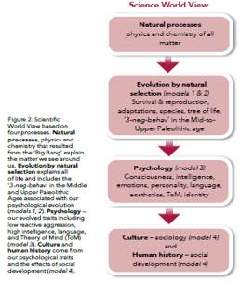
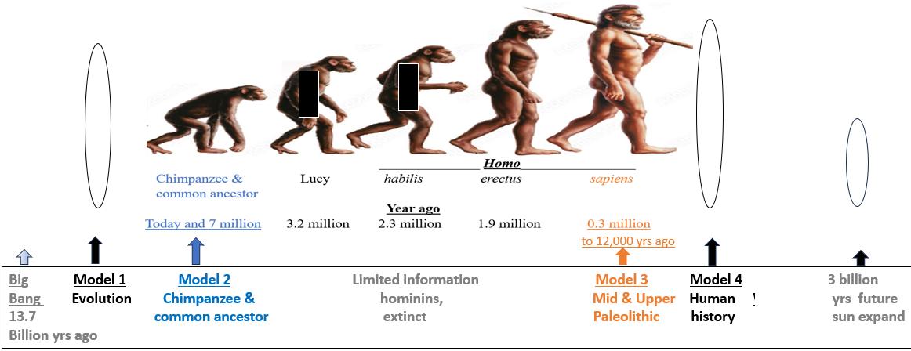
Science World View
JamesWalter889@gmail.com
Cell 708-776-3800

Slide 11
4.5 B earth
3.5 b life
1 billi multicell
500 mill Cambrian explosion
300 mill reptiles
250 Mill dinosaurs
200 mill mammals
65 mill end dinosaurs
7 mill common ancestor

